Slide 1

Parvatibai Genba Moze College Of Engineering, Wagholi, Pune
Department of Computer Engineering.
Cyberbullying Detection on social media
using Machine Learning
Under guidance of
Shrikant Dhamdhere
Group id:1
Harsh Agarwal
Jagruti Jadhav
Babita Jaybhaye
Komal Nagar

Slide 2
Cyberbullying Detection on social media using Machine Learning

Slide 3
Index
Introduction
Existing system
Limitation of Existing system
Proposed system
Model selection
SVM theory and computation
Features of system

Slide 4
Introduction
Reynolds had defined cyberbullying as “willful and repeated harm inflicted through the medium of electronic text”
Al- Garadi, Varathan and Ravana had defined it as “be a sub-type of aggressive behavior in which an individual or group of individuals repeatedly attack, humiliate and/or exclude a relatively powerless person”
Most of the victims of cyberbullying are teens which does not report to parents and hence attackers not get identified to prevent this we had to go to select automatic detection than traditional method

Slide 5
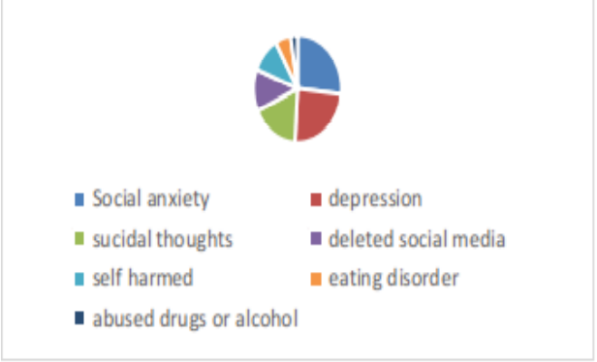
Effects of cyberbullying

Slide 6
Existing system
Existing system uses supervised machine learning technique to solve this problem general algorithms like Logistic regression, Navies bayes, Random forest, decision tree.
Features is based on textual and TF-IDF, word embedding are used to extract from text.
Evaluation metrics for all systems are accuracy, precision, recall, F1-score are used

Slide 7
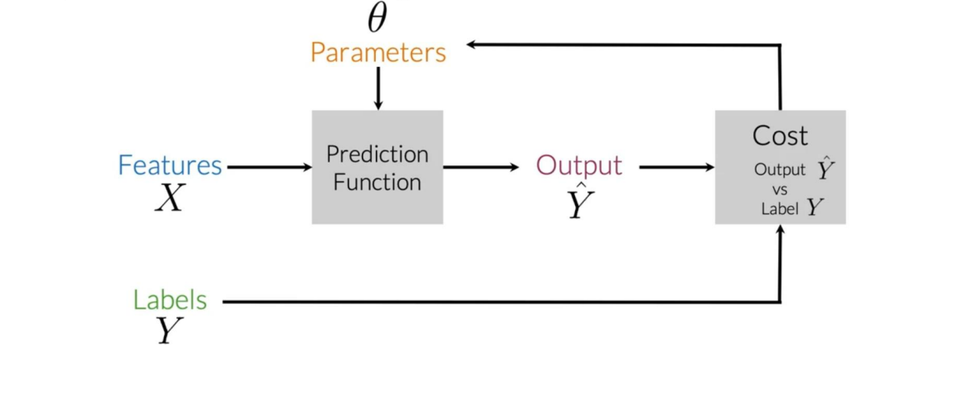
Supervised ml

Slide 8
Limitations of existing systems
*There are no large dataset available for detection of problem
the dataset is not properly annotated
*User based features are not considered.

Slide 9
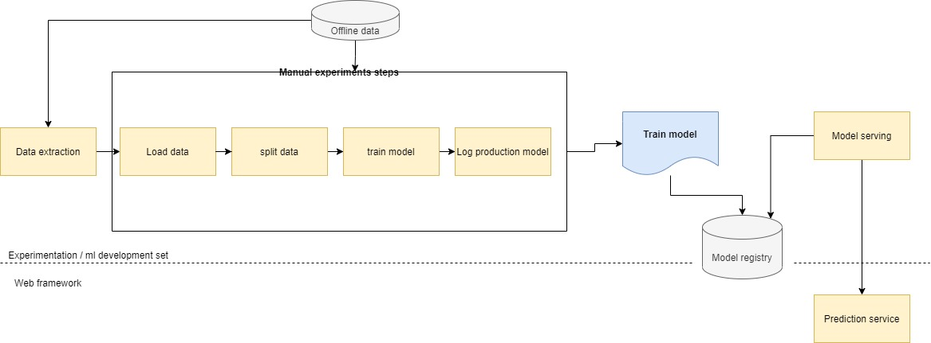
Proposed system design

Slide 10
Cyberbullying detection
X->Train model->Classify
(SVM)
I am happy because I am learning ML
Positive:1

Slide 11
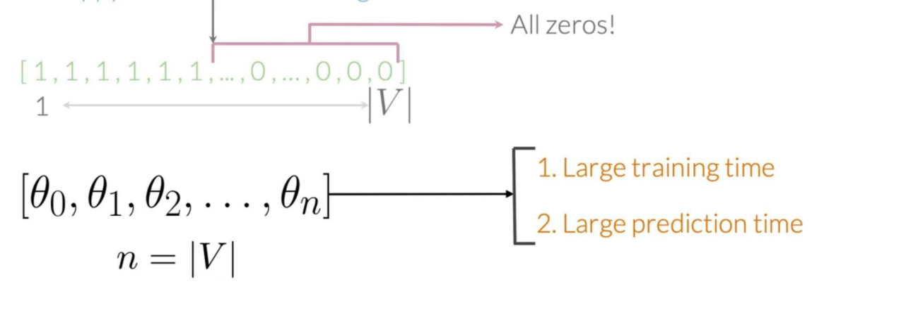
Problems with sparse representation
I am happy because I am learning ML

Slide 12
Feature Extraction
I am happy because I am learning ml
[‘I’, ‘ am ’ ,’ happy ’, ‘learning’ , ‘Ml ’ , ……, ‘ hated’, ‘the’, ‘ movie’ ]
[1, 1, 1, 1,1 , ……, 0,0,0,0 ]

Slide 13
Vocabulary
I am happy because I am learning ml
..
…..
…….
I hated the movie
Comments:
[Comment1,comment2,Comment3,…,Commentn]
V=
[‘I’, ‘ am ’ ,’ happy ’, ‘learning’ , ‘Ml ’ , ……, ‘ hated’, ‘the’, ‘ movie’ ]

Slide 14



Preprocessing: Stemming and lowercasing
I hate running.
HATE
Hate
hate
hate
running
Run
Preprocessed Comment
Runs
[ i , hate, run ]

Slide 15
Preprocessing: stop words and punctuation
Punctuation
,
.
:
!
?
“
‘
Stop words
And
Is
A
Has
At
For
of
Thats pretty damn awesome! Very smart :) @Aaronage Sure!

Slide 16
Positive and Negative Counts
Corpus
Vocabulary
I
Am
Happy
Because
Ml
Sad
Not
learning
I am happy because I am learning ml
I am happy
I am sad I am not learning ml
I am sad

Slide 17
Positive and negative counts
Positive comments
Vocabulary Pos freq(1)
I 3
Am 3
Happy 2
Because 1
Ml 1
Sad 0
Not 0
learning 1
I am happy because I am learning ml
I am happy

Slide 18
Positive and negative counts
Vocabulary | Neg Freq(0)
I | 3
am | 3
happy | 0
because | 0
learning | 1
l | 1
sad | 2
not | 1
Negative comments
I am sad, I am not learning ml
I am sad

Slide 19
Word frequencies in classes
Vocabulary | Pos frequency(1) | Negative frequency(0)
I | 3 | 3
Am | 3 | 3
Happy | 2 | 0
Because | 1 | 0
Learning | 1 | 1
ml | 1 | 1
Not | 0 | 1
sad | 0 | 2
Freq’s: Dictionary mapping from words , class to frequency

Slide 20
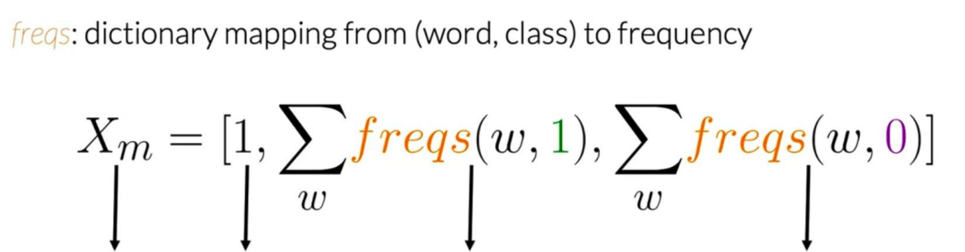
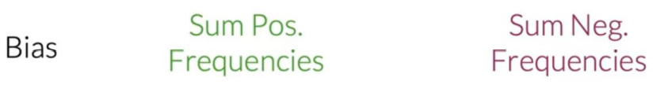
Feature extraction
Features of Comment_m

Slide 21
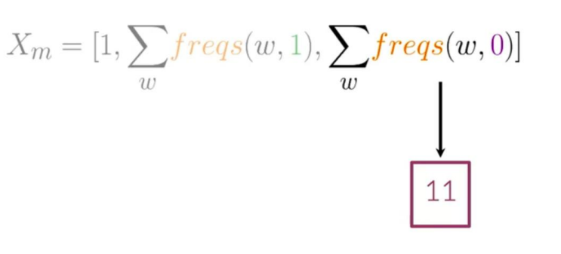
Feature Extraction
Vocabulary | Negative frequency(0)
I | 3
Am | 3
Happy | 0
Because | 0
Learning | 1
ml | 1
Not | 1
sad | 2
I am sad I am not learning ml

Slide 22
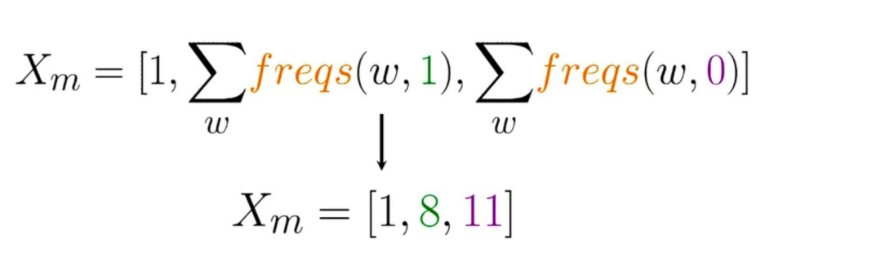
Feature extraction
I am sad I am not learning NLP

Slide 23
Overview
I am happy because I am learning NLP @Nptel
Preprocessing
[happy, learn, NLP]
Feature Extraction
Bias
[1,4,2]
Sum of negative frequencies
Sum of Positive frequencies

Slide 24
Overview
I am happy because I am learning ml @Nptel
I am sad I am not learning ml
……..
I am Sad ☹
[Happy, learn, ml]
[sad, not, learn, ml]
….
[sad]
[[1,40,20],
[1,20,50],
……….
[1,5,35]]

Slide 25



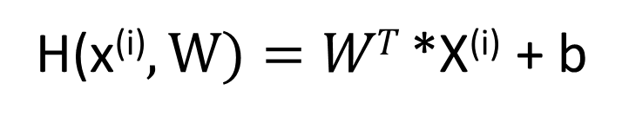
Overview of SVM
H(x^{(i)}$,W)=WT$ *X^{(i)} + b

Slide 26
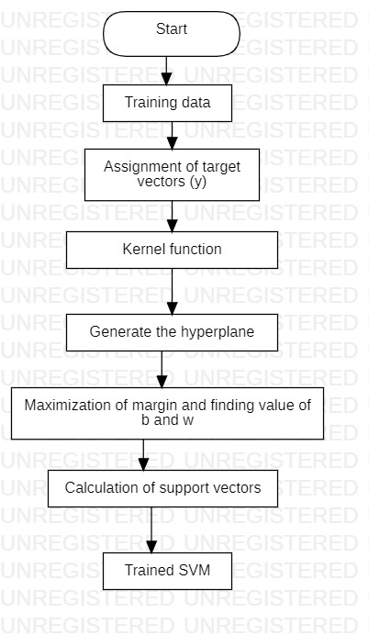
Algorithm of SVM
Training input(X)=[8,
11]
Training output(Y)=[1]
Weights(W)=[0.41,
-0.16]
Bias(B)=0.34
Prediction function(h)=[W^{T}.X]+b
[8 [ -0.16 0.41]
11]
[]
h=[8*0.41+(-0.16)*11]+0.34
h=[3.28-1.76]+0.34
h=1.86
h>=0
This says that the cyberbullying is detected if this h is less than 0 we get the cyberbullying activities not detected
For more details

Slide 27

Testing of SVM
[0
1
1
.
.
.
pred_{m}]
[0
0
1
.
.
.
Y_{testm}]
X_{test}, Y_{test}, W
h(X_{test}, W)
[ 1
0
1
.
.
.
Pred_{m} == y_{testm} ]
Pred= h(X_{test}, W)>=0

Slide 28
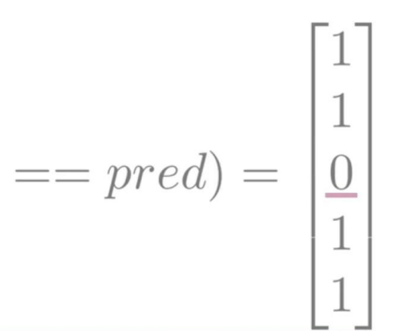
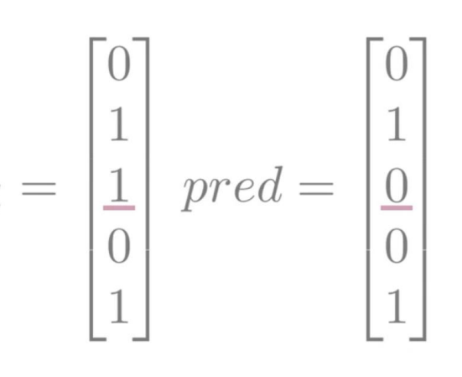
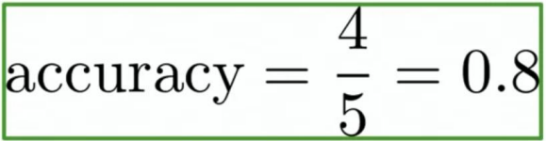
Testing of SVM
(Y_{test}
Y_{test}

Slide 29
Features
Manual, script-driven, and interactive process
Deployment is in form of prediction service which contains both API and webapp
Code had been modularized in form of pipelines for experimentation purpose

Slide 30
Thank you

